Slide 1
Maximum entropy classifiction
From: LeChuck@yahoo.com
Har har!
Allow mes to introduce myself. Myname is Lechuck ,and I got your email from the interwebs mail directory. I threw a dart at the directory and hit your name. You seam like a good lad based on your name, so I here I am writing this email.
I live out here in this faraway island, and I have some moneys ($122K USD, to be exact) that I need to send overseas. Could you do mes a favor and help me with my moneys transfer?
1) Provide mes a bank account where this money would be transferred to.
2) Send me a picture of yourselfs so I know who to look for and thank when I sail to the US. Click heres to my Facebook [www.lechuck.myfacebook.com/fake.link/give_me_money] and post me your pic.
Monkeys bananas money rich
As reward, I are willing to offer you 15% of the moneys as compensation for effort input after the successful transfer of this fund to your designate account overseas. please feel free to contact ,me via this email address lechuck@yahoo.com

Slide 2
Features and weights
F1=Email contains spelling/grammatical errors
F2=Email asks for money to be transferred
F3=Email mentions account holder’s name
Weights for spam
W1 =Email contains spelling/grammatical errors): 0.5
W2=Email asks for money to be transferred): 0.2
W3=Email mentions account holder’s name): -0.5
Weights for not spam
W1=(Email contains spelling/grammatical errors): -0.2
W2=(Email asks for money to be transferred): 0
W3 =(Email mentions account holder’s name): 1

Slide 3
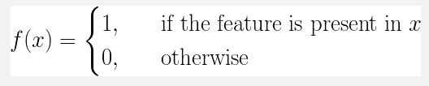

Function
Formula

Slide 4
F1=Email contains spelling/grammatical errors -Yes
F2=Email asks for money to be transferred-Yes
F3=Email mentions account holder’s name-No

Slide 5
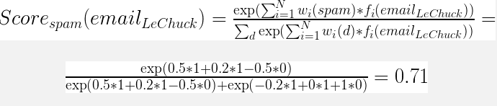
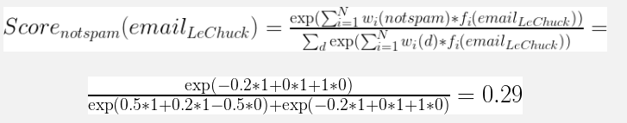
Spam score
Not spam score

Slide 6
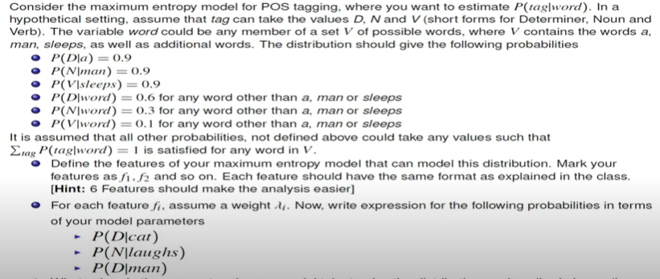
Example2

Slide 7
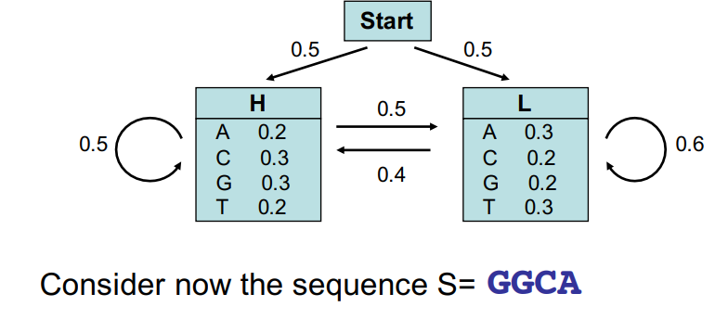
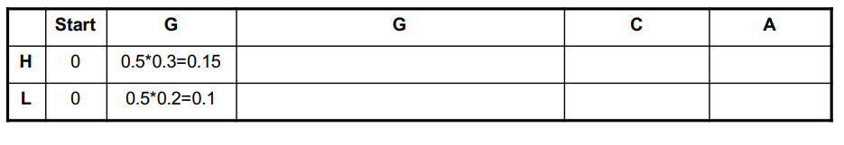
Forward algorithm-example

Slide 8
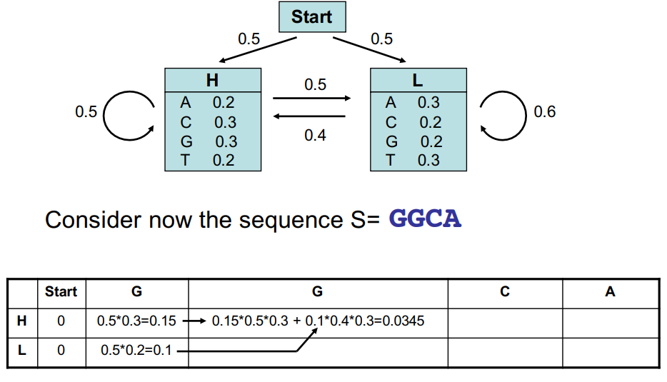

Slide 9
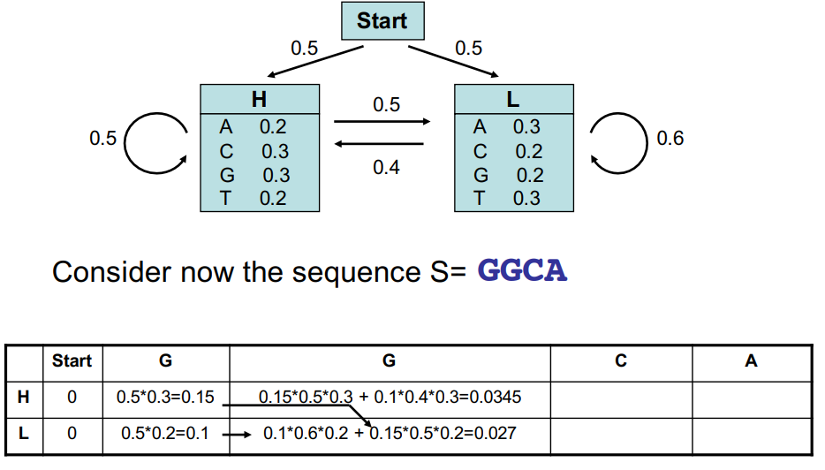

Slide 10
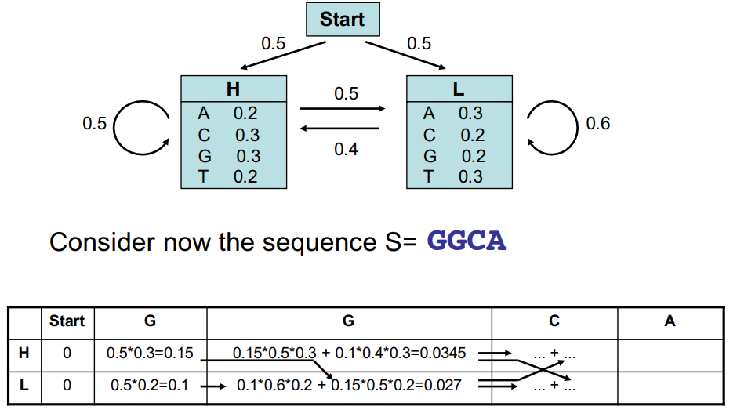

Slide 11
